Slide 1
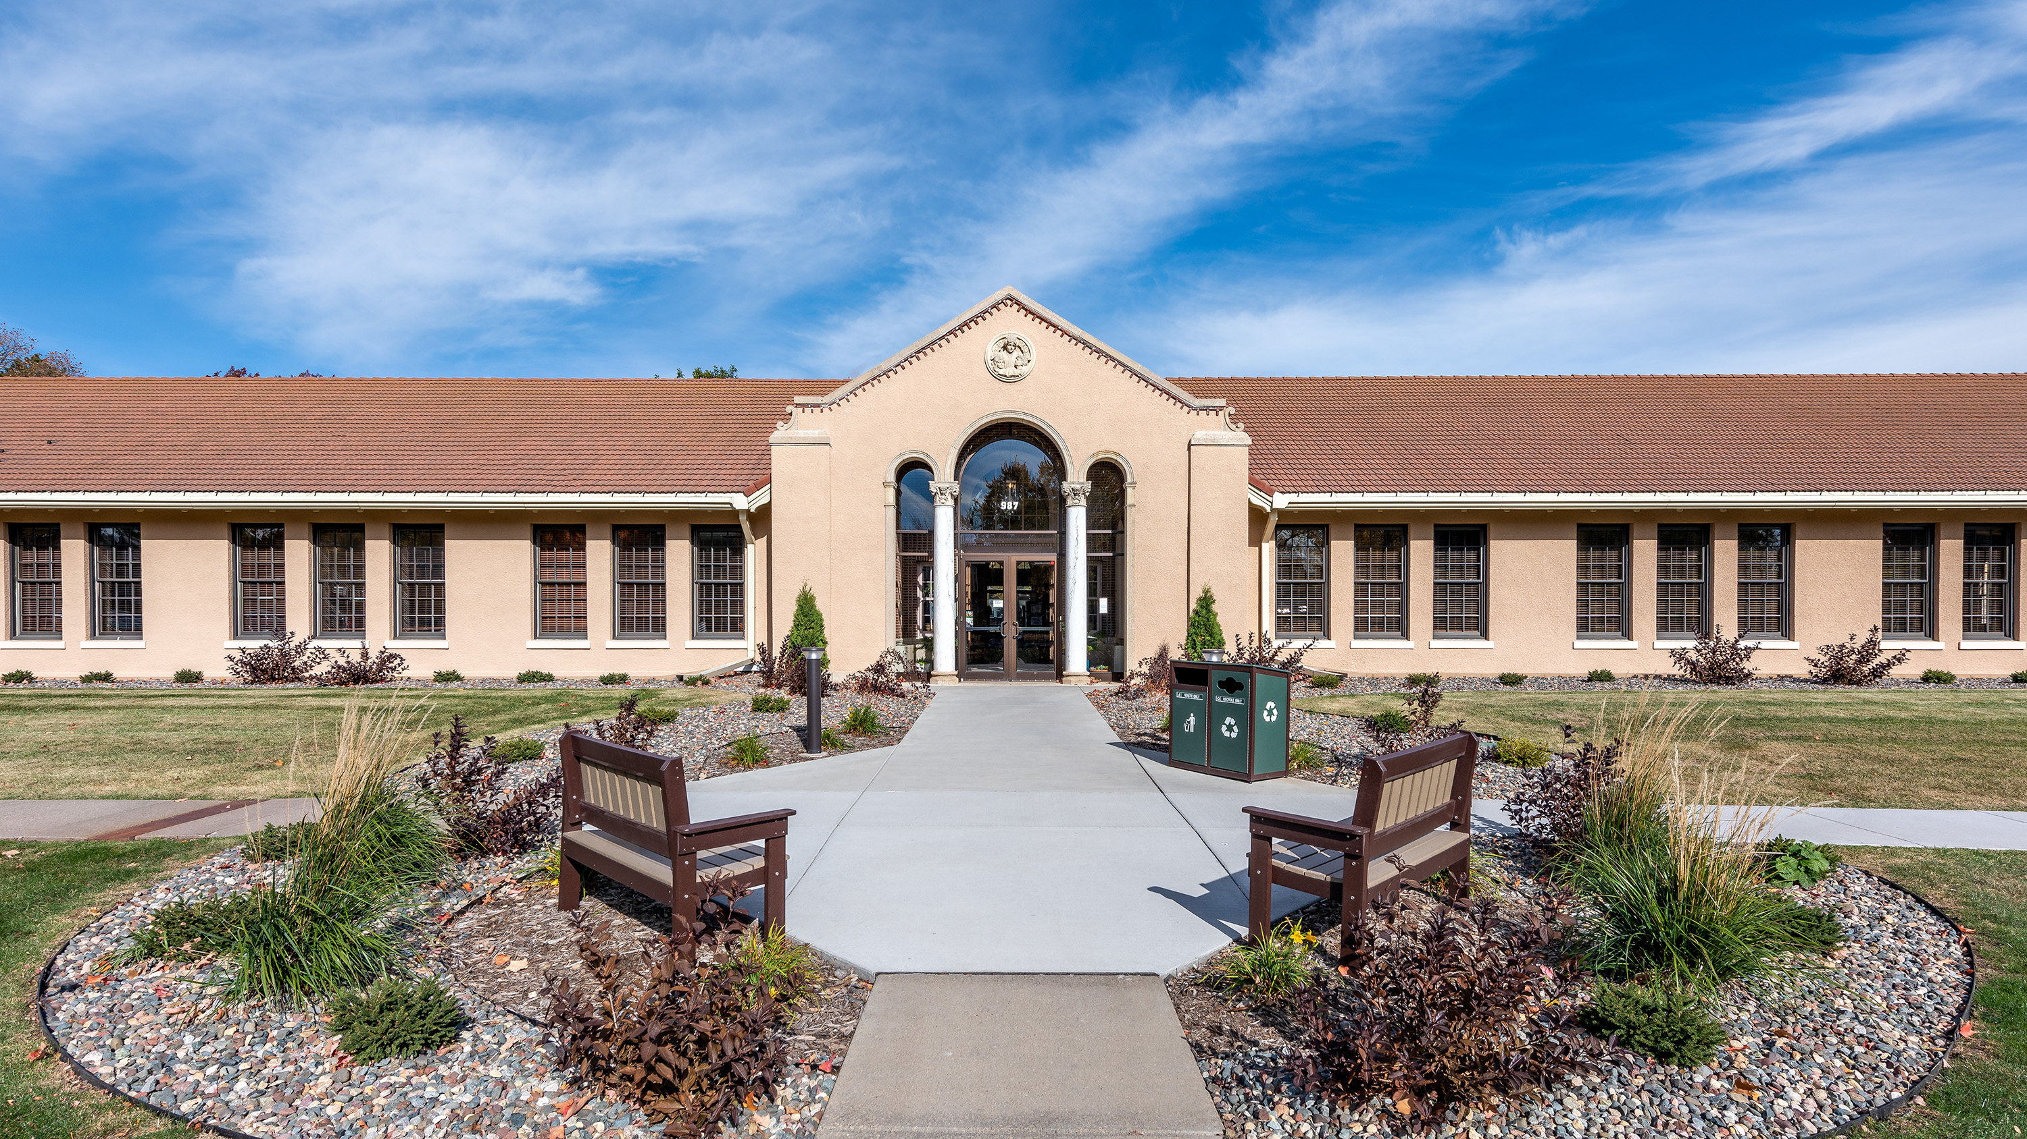
2023-25 Open Grant Opportunities
MINNESOTA
HUMANITIES
CENTER
Information Session

Slide 2
BEFORE WE GET STARTED
This session will be recorded. Link will be available at mnhum.org/what-we-do/grants within a few days.
Mics & video will be off for participants to start. Mics and video optional for Q & A.
If you have questions, please type them in the chat box at anytime.
We will respond to questions after our opening remarks. Some questions may take further consideration before we provide a response. All questions will be posted in the FAQs at mnhum.org/what-we-do/grants.
© 2023 Minnesota Humanities Center

Slide 3
AGENDA
ABOUT MHC
GRANT OPPORTUNITIES
GRANTS OVERVIEW & GOALS
ELIGIBILITY & EVALUATION
HOW TO APPLY
Q&A
© 2023 Minnesota Humanities Center

Slide 4
WHO WE ARE
Laura Adams, Grants Administrator
651-772-4244, Laura.Adams@mnhum.org
Tristy Auger, Grants Manager
651-772-4251, Tristy@mnhum.org
Casey DeMarais, Director of Strategic Partnerships
651-772-4278, Casey@mnhum.org
© 2023 Minnesota Humanities Center

Slide 5
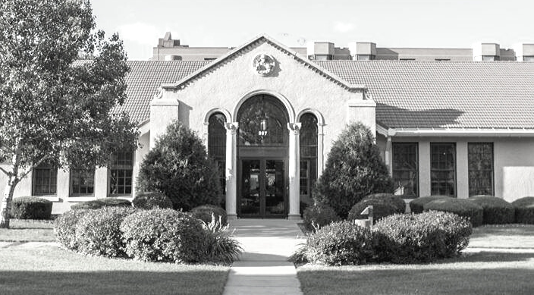
ABOUT MHC
FOUNDED IN 1971
MHC was created when the National Endowment for the Humanities began funding state-based humanities programs
MISSION
VISION
MHC connects our past to the present, to increase shared understanding, and spark positive future change.
A just society that is curious, connected, and compassionate

Slide 6
LEGACY FUNDING
Clean Water, Land, and Legacy Amendment
Three-eighths of one percent of sales tax revenue is dedicated to Clean Water, Land, and Legacy; 19.75% is dedicated to the Arts & Cultural Heritage projects.
Appropriated every two years (2023-2025) by MN State Legislature.
During the 2023-25 biennium, MHC will administer $12 million in grants to individuals and/or organizations in Minnesota working to create, celebrate, and teach the art, culture, and heritage of diverse Minnesota communities.
© 2023 Minnesota Humanities Center
Notes:
to ensure clean water, preserve opportunities for Minnesotans to enjoy nature, parks, and trails, and to appreciate arts and culture that exists within the State.

Slide 7
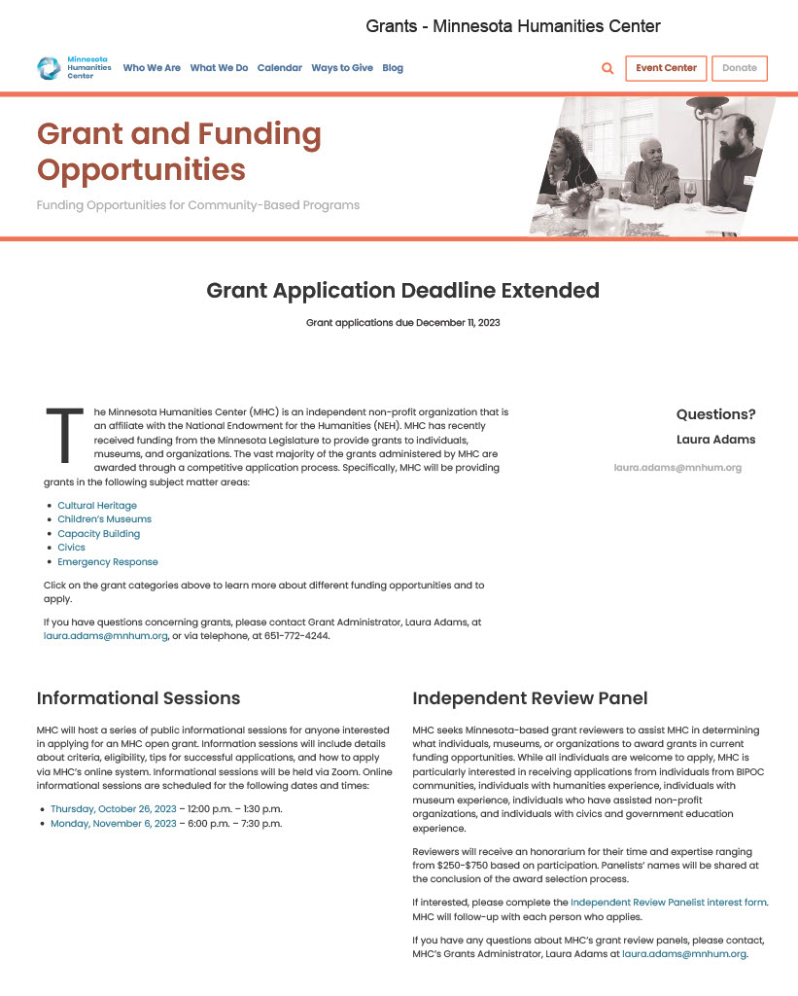
GRANT OPPORTUNITIES
COMMUNITY IDENTITY & HERITAGE GRANT PROGRAM
Cultural Heritage
Emergency Response
Capacity Building
CHILDREN’S MUSEUM GRANTS
CIVICS GRANTS
mnhum.org/what-we-do/grants
© 2023 Minnesota Humanities Center
Notes:
Talking points – review MHC grants pages for all the details. We’ll review some of the highlights together now but refer to these web pages for all details – full request for proposals that contain all the details about the specifics about funding availability, eligibility, timeline, selection process, how to apply, application contents/elements, funding limitations, additional information, and technical support. You can access FAQs, budget template, and information about the Legacy funding (purpose, intent, etc.)
Laura, drop Grants landing page in Zoom chat https://www.mnhum.org/what-we-do/grants/

Slide 8
FUNDING AVAILABLE via MHC
LEGACY FUNDS
Community Identity & Heritage Grant Program
Cultural Heritage
Emergency Response
Capacity Building
$ 8,000,000
$ 100,000
$ 750,000
Children’s Museums Grants
Civics Grants
$ 3,200,000
$ 300,000

Slide 9
ELIGIBILITY
Cultural organizations are eligible to apply for Cultural Heritage, Capacity Building, and Emergency Response funding.
Children’s Museums are eligible to apply for Children’s Museum funding.
Cultural organizations and/or civics programs are eligible to apply for Civics funding.
Individuals are eligible to apply for Cultural Heritage funding.
Fiscal Sponsors are eligible to apply for all open opportunities.
Applicants must be in good standing with the Internal Revenue Service (IRS) & MHC.
Applicants may submit multiple applications across open funding opportunities.
e.g. one for Cultural Heritage and one for Capacity Building
Applicants meeting all financial requirements are eligible for funding.
Notes:
Organization and/or individual is in good standing with the IRS when they have completed all IRS reporting requirements and can receive tax-deductible charitable contributions. MHC uses the IRS Tax Exempt Organization Search to confirm compliance.
Organization and/or individual that has failed to complete a prior grant, has a history of inconsistent and inaccurate financial reporting, or a history of overdue reports may not be in good standing with MHC.
MHC may grant an exemption to an organization that is not in good standing if the applicant uses a fiscal agent.
An organization may submit multiple applications; however, the organization is only eligible to receive one (1) Cultural Heritage grant. An organization can collaborate on other applications submitted to MHC provided that it is not named as the organization that would be the Cultural Heritage grant award recipient.
Applicants may submit multiple proposals; however, they are only eligible to receive one grant per open opportunity. An applicant can collaborate on other projects submitted to MHC provided it is not named as the grant award recipient.

Slide 10
STATE REQUIREMENTS
Legacy requires proposed and/or awarded fundings support new work or new additions to existing work. These funds must supplement, not substitute, other funding sources – in other words, this grant cannot replace expenses for ongoing projects.
P
I and/or my organization has a program or project that we have been running for many years, and we want to apply for funding to add on a new aspect or element to our program.
I and/or my organization has a program or project that we have been running for many years, and our usual funding source is gone. We want to apply to this grant to keep it going.
© 2023 Minnesota Humanities Center

Slide 11
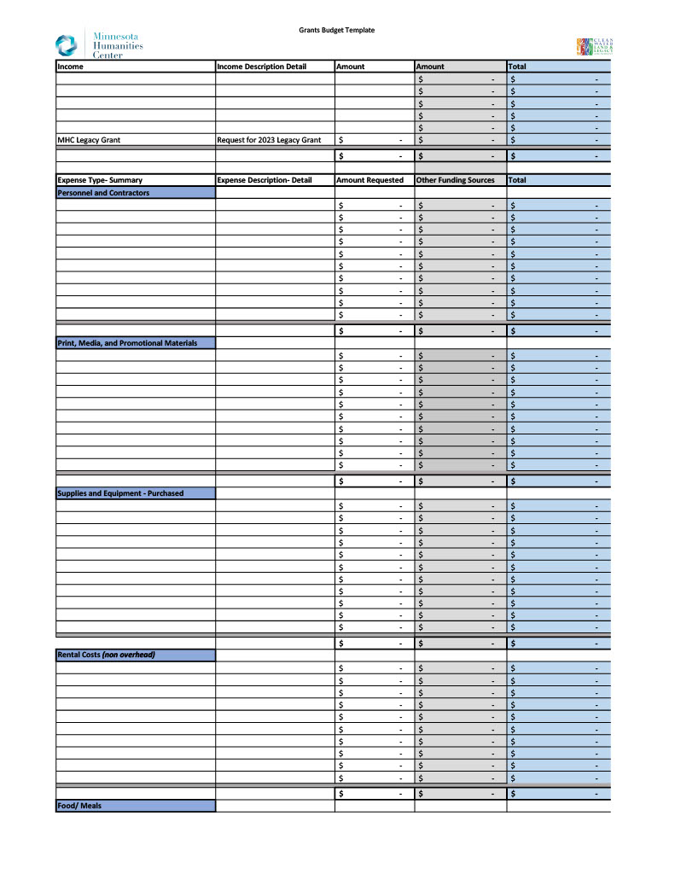
ALLOWABLE EXPENSES
Wages, salary, and benefits of staff working on the project:
hours or proportionate salary spent by the individual working on the project.
Compensation due to independent contractors for designing, administering, and implementing the project.
Capacity Building:
AND expenses for business consultants and nonprofit management experts for their time providing training and coaching.
Emergency Response:
AND expenses incurred to process grieving, encourage healing, create memorials, and assist the community in recovery.
Notes:
Budget Template

Slide 12
EXPENSES NOT ALLOWED
There are some expenses that will not be considered within a grant proposal:
Expenses for travel outside of the State of Minnesota,
Durable equipment such as iPads, computers, monitors and AV,
Support capital costs (such as improvements, construction, property, or equipment),
T-shirts, promotional items, or gifts given to promote the applicant’s brand,
Food expenses when expenses are either (i) incurred during the planning phase of the project, or (ii) are not essential to the final program,
Wages, salary, and benefits of staff for the time that such individuals are not working on the project, and
Start, match, or add to any type of capital campaign.

Slide 13
LEGISLATIVE GOALS
Cultural Heritage Grants
$8,000,000
Aligning with the intent and legislative language of this grant opportunity, the goals of these grants are to:
Preserve and honor the cultural heritage of Minnesota.
Provide education and student outreach on cultural diversity.
Expand the development of culturally diverse humanities programming in Minnesota.
Empower communities in building identity and culture.
Aligning with the outcomes of Legacy, these grants should also:
Amplify arts, culture, and heritage in Minnesota.
Increase the depth and breadth of Minnesotans who will connect with arts, culture, and heritage.

Slide 14
LEGISLATIVE GOALS
Capacity Building Grants
$750,000
Aligning with the intent and legislative language of this grant opportunity, the goals of these grants are to:
Provide funding to cultural organizations that have a history of working with diverse cultural communities
Assist them with grant writing, fundraising, and capacity building, to develop into more robust cultural organizations.
Aligning with the outcomes of Legacy, these grants should also:
Amplify arts, culture, and heritage in Minnesota.
Increase the depth and breadth of Minnesotans who will connect with arts, culture, and heritage.

Slide 15
LEGISLATIVE GOALS
Emergency Response Grants
$100,000
Aligning with the intent and legislative language of this grant opportunity, the goals of these grants are to:
Provide funding to organizations within Minnesota that have a history of working with diverse cultural communities
Quickly assist community in responding to a crisis or major events brought about by violence, strife, intolerance, or hatred.
Aligning with the outcomes of Legacy, these grants should also:
Amplify arts, culture, and heritage in Minnesota.
Increase the depth and breadth of Minnesotans who will connect with arts, culture, and heritage.

Slide 16
LEGISLATIVE GOALS
Children’s Museums Grants
$2,200,000
Aligning with the intent and legislative language of this grant opportunity, the goals of these grants are to provide funding to Children’s Museums in Minnesota.
Priority will be given to the following:
Youth education,
New exhibits,
Outreach to underserved and diverse communities, and
Programming that celebrates cultural diversity.

Slide 17
LEGISLATIVE GOALS
Civics Grants
$300,000
Aligning with the intent and legislative language of this grant opportunity, the goals of these grants for programs and organizations in Minnesota who:
Provide civics education for youth on law, democracy, government, and or debate.
Conduct civics education programs.

Slide 18
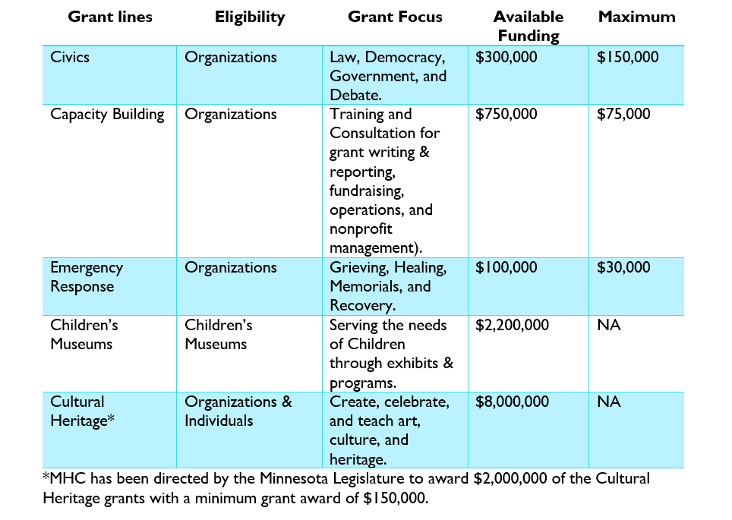
PROPOSALS
HOW MUCH TO REQUEST?
HOW LONG DO WE HAVE TO SPEND THE GRANT?
Determine how long the proposed activities will take.
Could be 12 months, or less, or longer.
Must be completed no later than May 30, 2025.

Slide 19
STRONG PROPOSALS
Answer all the prompts/questions.
Start your proposal early:
Review the PDF of the full proposal.
Take advantage of the support from MHC.
Use the budget template.
Make sure the emphasis is on the intent and goals of the funding opportunities.
Review Selection Criteria for each grant opportunity; tailor your narrative to those prompts specifically.
Don’t submit anything not required.

Slide 20
EVALUATION PROCESS
Applicants will go through a financial review process.
Each applicant will be reviewed on a point scale (posted in each RFP).
Scoring factors vary between open grant opportunities (see RFP for details).
In general, factors include:
Project Details
How well does the project meet the specific grant goals?
Involvement
Community/stakeholders/board involvement?
Project Management
Project completion, expense reporting, goals achieved, compliance, etc.?
Evaluation
How will you know you’ve been successful?
Impact
Who is the audience, how do you expect to impact this audience?

Slide 21
Important Dates
MHC can review/provide feedback of narratives & budget until December 4, 2023
11:59 p.m., CDT, December 11, 2023 – APPLICATION DEADLINE!!
Applications under review – December 2023
Award Notifications – January/February 2024
EXCEPT: Emergency Response applications will be accepted on a rolling basis until October 15, 2024 (or all funds are expended)

Slide 22
POST SELECTION
Award process will include:
Grantee orientation meeting
Contract development
Payment schedules
Grant terms (start and finish)
Reporting requirements
Reporting schedule (interim and final)
Site visit schedule (as needed)

Slide 23
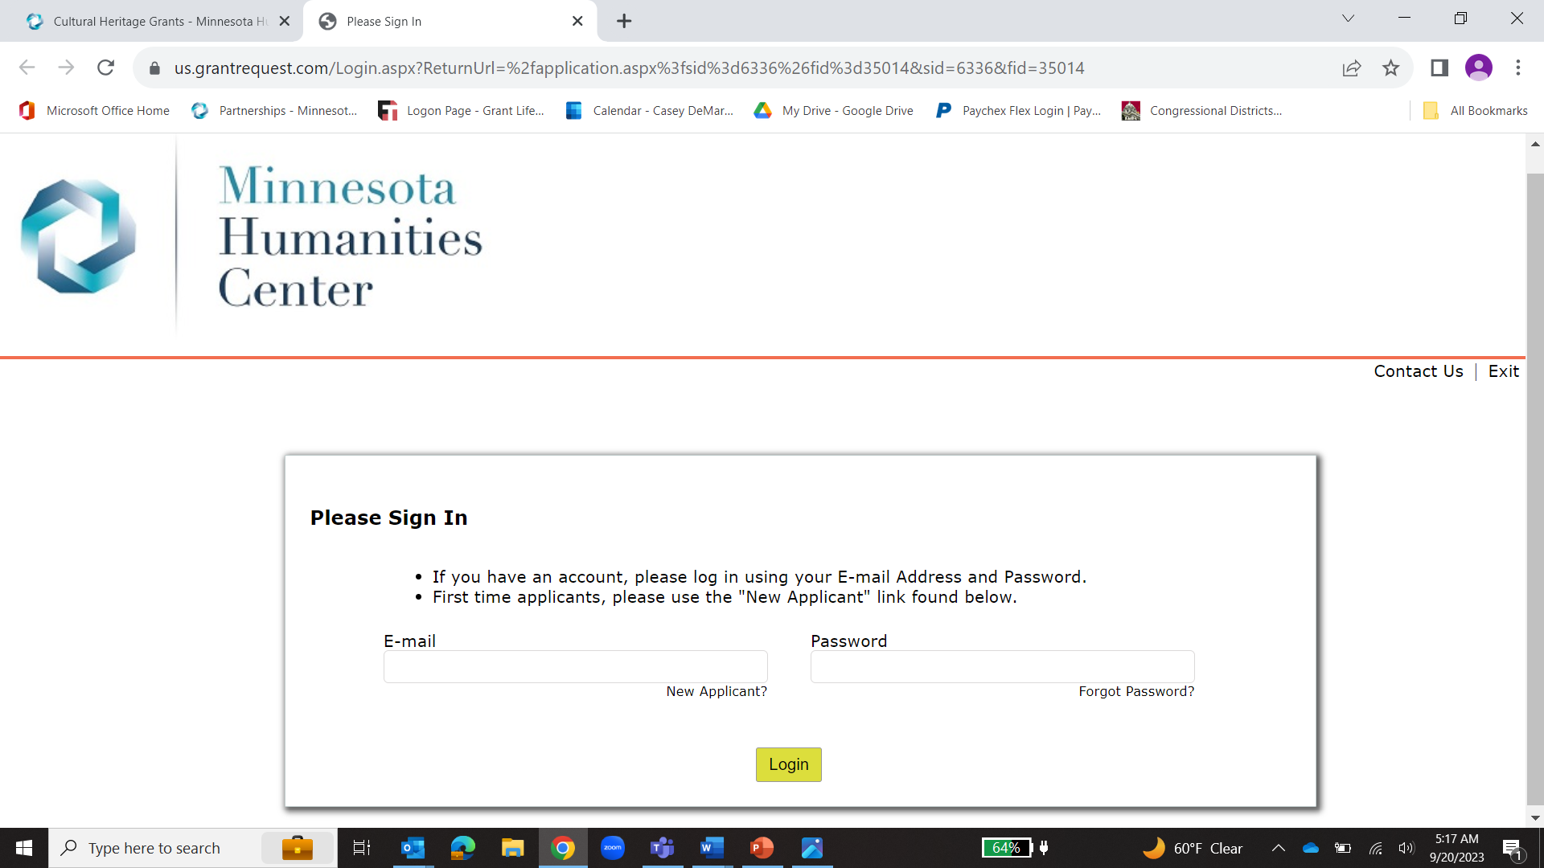
HOW TO APPLY
Complete an online application
- OR -
Complete PDF application (w/required attachments) email to submissions@mnhum.org

Slide 24
Q & A

Slide 25
THANK YOU
More information and links can be found on our website: mnhum.org
OR contact:
Laura Adams
Grants Administrator
651-772-4244
Laura.Adams@mnhum.org
If applying in English is a barrier or you need a reasonable accommodation to submit your application, please contact Laura Adams.

